Slide 1
Prefixes, suffixes and root words
Introduction
Notes:
This lesson is a follow on lesson from ‘Homophones’

Slide 2
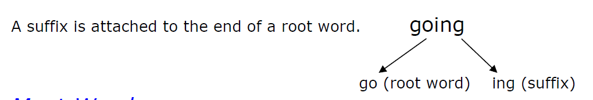
Root words
A root word is a real word and you make new words from it by adding prefixes and suffixes.
Root words are helpful because:
You can use a root word to help you with other spellings.
If you recognise the root of a word when you are reading it can help you to work out what the word is and what it means.
There are spelling rules for adding suffixes and prefixes to root words.
successful
Learning
Learn ing
Success ful

Slide 3
Suffixes
Adding suffixes to words can change or add to their meaning, but most importantly they show how a word will be used in a sentence and what part of speech (e.g. noun, verb, adjective) the word belongs to. e.g. If you want to use the root word 'talk' in the following sentence:
I was (talk) to Samina.
You need to add the suffix 'ing' so that the word 'talk' makes better sense grammatically:
"I was talking to Samina".

Slide 4
suffixes
Activity 1:
In pairs write down as many suffixes as you can think of.
You have 5 minutes!

Slide 5
Suffix | Example |  | Suffix | Example
ed | walk + ed = walked |  | ness | happy + ness = happiness
ing | say + ing = saying |  | al | accident + al = accidental
er | tall + er = taller |  | ary | imagine + ary = imaginary
tion | educate + tion = education |  | able | accept + able = acceptable
sion | divide + sion = division |  | ly | love + ly = lovely
cian | music + cian = musician |  | ment | excite + ment = excitement
fully | hope + fully = hopefully |  | ful | help + ful + helpful
est | large + est = largest |  | y | ease + y = easy

Slide 6
Suffixes... Common errors
-less with less than two ss is useless.
Careless hopeless relentless
Root words ending in ‘e’. Remember to drop the ‘e’ when adding ‘ing’!
Take + ing = taking make + ing = making
-ful is always a three-letter word - unless it's used as a word on its own:
Someone who's full of care is careful.
Mindful successful hopeful regretful

Slide 7
Prefixes
A prefix is a group of letters which you can add to the beginning of a root word to change the meaning of the word.
e.g. mis + fortune = misfortune
Prefix meanings: Every prefix has a meaning, for example: The prefix 'un' means 'not' The root word 'clear' means 'bright', 'free from difficulty' un + clear = unclear which means 'not clear' or 'dim', 'difficult to see or understand'

Slide 8
prefixes
Activity 1:
In pairs write down as many prefixes as you can think of.
You have 5 minutes!
Extra points if you can also write down the meaning of the prefix!

Slide 9
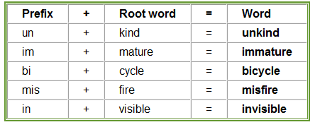
Prefixes
Generally when you add a prefix to a root word the spelling of the prefix and the root words stays the same.
(Think of mobile phone tariffs, you can choose to add ‘bolt ons’ to your contract to suit a purpose)
Notes:
Table taken from www.bbc.co.uk/skillswise/prefixes

Slide 10
prefixes... Common errors
When the prefix 'all' is added to a root word the final 'l' of 'all' is dropped. all + together = altogether all + ways = always
dis – only has one ‘s’ when being used at the start of a word:
Dis+ appear + disappear dis + respect = disrespect

Slide 11
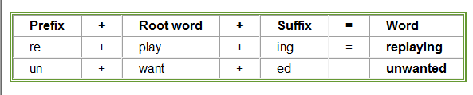
Mix it up!
You can also add a prefix to a word which already has a suffix added to it.

Slide 12
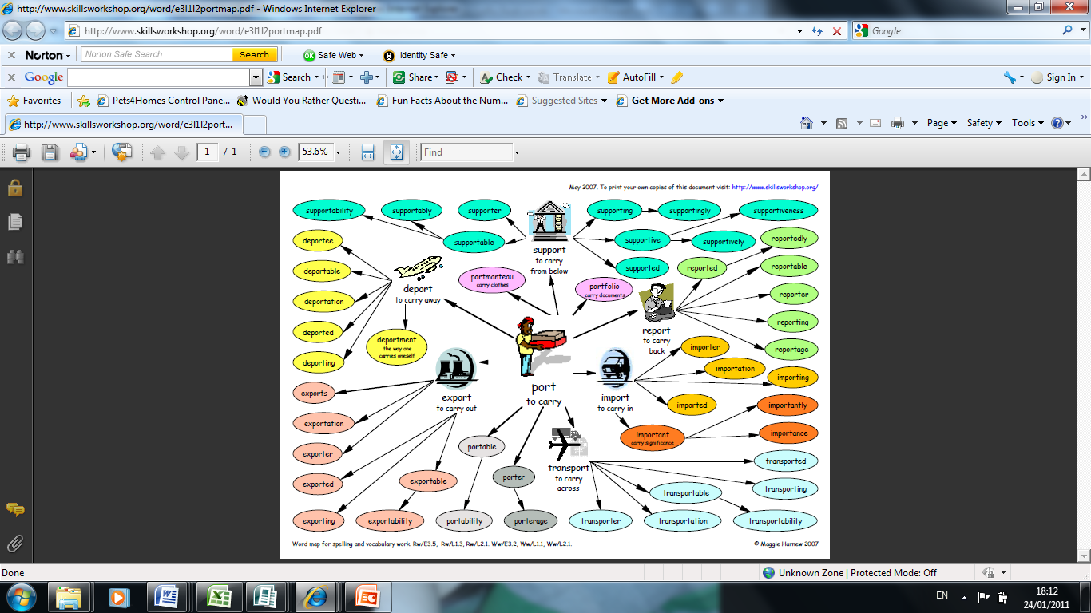
How many words can you make?
Notes:
Word map used from www.skillsworkshop.org

Slide 13
Answer
Notes:
Word map used from www.skillsworkshop.org

Slide 14
Instructions: as you read this paragraph, underline all words that have prefixes or suffixes. Write them below the paragraph and then write a definition of the word
The Garbage Problem Improper garbage disposal can cause contamination of subterranean water sources. Relocating garbage dumps doesn’t necessarily solve this incredibly unhealthful problem. Laws preceding the discovery of this problem were predictably relaxed in terms of garbage disposal. Since the discovery, authorities have proceeded to toughen these laws and have injected funds into reevaluating ongoing practices. Interjection of environmental organizations has helped to convince an incredulous public of the depth of the problem and the need to recycle. Some garbage dumps have receded in size, but most have increased as the unbelievable amount of garbage produced continues to multiply unnecessarily.

Slide 15
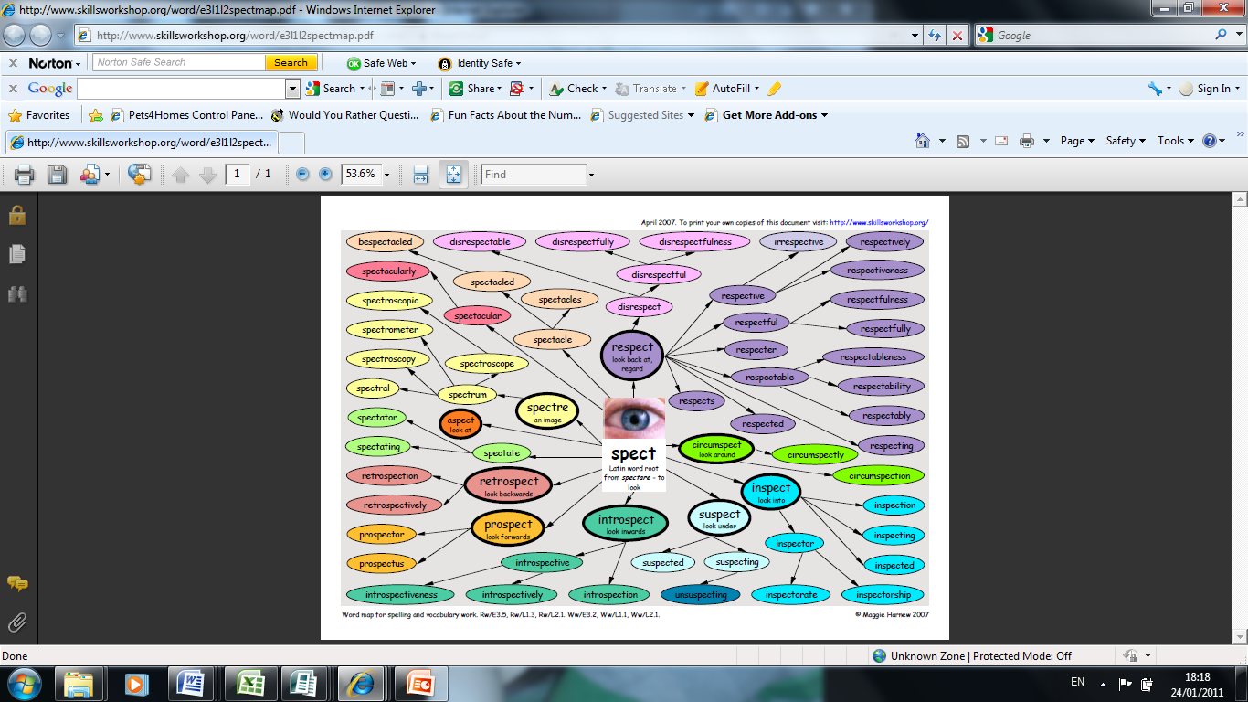
Create your own word map
Choose a root word from the list below and create a word map adding suffixes and prefixes.
spect – use
late act
If you are uncertain whether the prefix you have used is correct, check the word in a dictionary when you proof-read your writing!

Slide 16
Word maps
Notes:
Word map used from www.skillsworkshop.org

Slide 17
To sum up
A root word is...
A suffix is...
For example:
Identify the prefix in the word below:
Antibacteria
Is it ‘full’ or ‘ful’ and the end of a word?
Is it ‘dis’ or ‘diss’ at the start of a word?

